Slide 1
Socket programming
Tasos Alexandridis

Slide 2
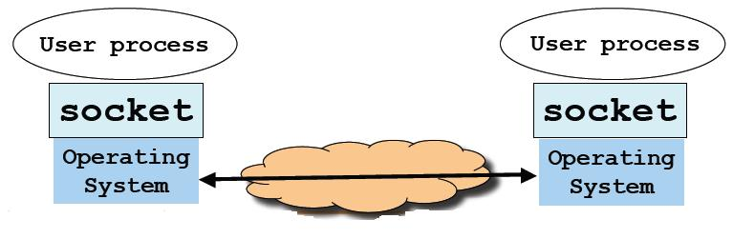
Socket: End Point of Communication
Sending message from one process to another
  Message must traverse the underlying network
Process sends and receives through a socket
  In essence, the doorway leading in/out of the house

Slide 3
Identifying the Receiving Process
Sending process must identify the receiver
  Address of the receiving end host
  Identifier (port) that specifies the receiving process
Receiving host
  Destination IP address (32-bit) uniquely identifies the host
Receiving process
  Host may be running many different processes
  Destination port (16-bit) uniquely identifies the socket (process)

Slide 4
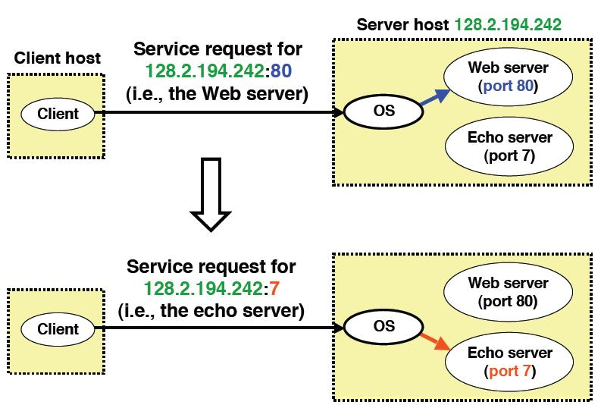
Using ports to identify Services

Slide 5
Using sockets in C
The UNIX Socket API

Slide 6
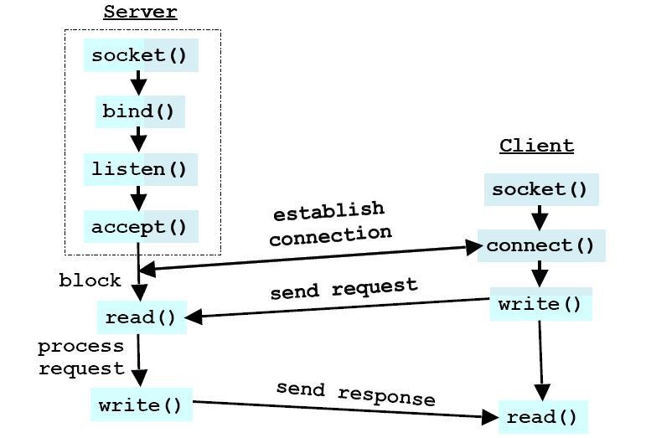
Overview

Slide 7
socket()
int socket(int domain, int type, int protocol)
  Creates a socket
Domain specifies the protocol family
  AF_UNIX, AF_LOCAL for local communication
  AF_INET for IPv4 Internet protocols (use this)
Type specifies the communication
  SOCK_STREAM for TCP
  SOCK_DGRAM for UDP
Protocol specifies the protocol (set to 0 as domain and type imply the protocol)
RETURN
  On success returns socket descriptor, else -1

Slide 8
bind()
int bind(int socket, struct sockaddr *address, int addrLen)
  Assigns a specific address to the socket
socket → the socket descriptor
address → the host address
addr_len → the size of the address struct
RETURN
  0 on success, else -1

Slide 9
sockaddr & sockaddr_in
struct sockaddr_in {
short int sin_family; // Address family
unsigned short int sin_port; //Port number
struct in_addr sin_addr; //Internet address
unsigned char sin_zero[8];
};
struct in_addr {
unsigned long s_addr;
}
struct sockaddr_in addr;
struct sockaddr *address = (struct sockaddr *)&addr; //Type casting

Slide 10
listen()
int listen(int sockfd, int backlog)
  Listens (waits) for incoming connections
sockfd → the socket descriptor
backlog → max number of connections
RETURN
  0 on success, else -1

Slide 11
accept()
int accept(int sockfd, struct sockaddr *addr, socklen_t *addrlen)
  Accepts an incoming connection
sockfd → the socket descriptor (after a call to listen() )
addr →pointer to a struct that is filled with the client’s address (optional)
addrlen → the size of the addr struct
RETURN
  the new socket descriptor for the specific connection, or -1 if an error occurred

Slide 12
send() / receive()
ssize_t send(int sockfd, const void *buf, size_t len, int flags);
  send data using the specified socket
ssize_t recv(int sockfd, void *buf, size_t len, int flags);
  Receive data from the specified socket and store it to buf
sockfd → the socket descriptor
buf → buffer to send or receiver
len → the length of the buffer
flags → (set to 0)
RETURN
  The total number of bytes sent/received, else -1

Slide 13
connect()
int connect(int sockfd, const struct sockaddr *addr, socklen_t addrlen)
  Connect to a socket
sockfd →the unconnected socket descriptor
addr →the server’s address
addrlen → the size of the addr struct
RETURN
  On success 0, else -1

Slide 14
close()
int close(int fd)
  Closes the socket
fd → the socket descriptor
RETURN
  0 on success, else -1

Slide 15
Example
TCP Server and TCP client in C

Slide 16
Socket creation
int sock;
if((sock = socket(AF_INET,SOCK_STREAM,IPROTO_TCP)) < 0) {
fprintf(stderr,”Failed to create TCP socket”);
}
if(setsockopt(sock, SOL_SOCKET, SO_REUSEADDR, &optval, sizeof(optval)) < 0) {
fprintf(stderr,”could not reuse address”);
}
Reuse the same port number

Slide 17
Bind port to socket
struct sockaddr_in addr;
memset(&addr, 0 ,sizeof(addr)); //clear memory block for //addr
addr.sin_family = AF_INET;
addr.sin_addr.s_addr = INADDR;
addr.sin_port = htons(server_port);
if(bind(sock, (struct sockaddr *)&addr, sizeof(addr)) < 0) {
fprintf(stderr,”cannot bind socket to address”);
}

Slide 18
Wait for incoming connections
If(listen (sock, 5) < 0) {
fprintf(stderr,”error listening”);
}
Specifies max number of incoming connections

Slide 19
Client establishes connection
struct sockaddr_in sin;
struct hostent *host = gethostbyname(argv[1]);
sin.sin_addr = *(in_addr_t) *host->h_addr_list[0];
memset(&sin,0,sizeof(sin));
sin.sin_family = AF_INET;
sin.sin_addr.s_addr = server_addr; // = inet_addr(server_IP) ;
sin.sin_port = htons(server_port);
if(connect(sock, (struct sockaddr *)&sin, sizeof(sin)) < 0) {
fprintf(stderr, “cannot connect to server”);
}
use raw IP address

Slide 20
Accept incoming connections
struct sockaddr_in addr;
int addr_len = sizeof(addr);
int c_sock;
c_sock = accept(sock,
(struct sockaddr *)&addr, &addr, &addr_lin);
if(c_sock < 0) {
fprintf(stderr,”error accepting connection”);
}

Slide 21
Send data
int send_packets(char *buffer, int buf_len) {
sent_bytes = send(sock, buffer, buf_len, 0) ;
if(send_bytes < 0) {
fprintf(stderr, “send() failed”);
}
return 0;
}

Slide 22
Receive data
int receive_packets ( char *buffer, int buf_len) {
int num_received = recv(sock, buffer, buf_len, 0);
if(num_received < 0) {
fprintf(stderr,”recv() failed”);
} else if (num_received == 0) {
//sender has closed connection
return EOF;
} else {
return num_received;
}
What happens when data exceed buffer size?

Slide 23
#include the appropriate libraries
#include <unistd.h> /* access to system calls */
#include <sys/types.h> /*widely used types */
#include <netdb.h> /* gethostbyname() etc.*/
#include <arpa/inet.h> /*htons etc. */
#include <sys/socket.h> /*socket structs */
#include <netinet/in.h> /*internet sockets, sockaddr_in etc. */

Slide 24
Datagram Sockets (UDP)
Similar to stream sockets but:
  Use SOCK_DGRAM instead of SOCK_STREAM
  No need to establish and terminate connection
  Use recvfrom() and sendto() instead of recv() and send()
ssize_t recvfrom(int sockfd, void *buf, size_t len, int flags, struct sockaddr *src_addr, socklen_t *addrlen);
ssize_t sendto(int sockfd, const void *buf, size_t len, int flags,const struct sockaddr *dest_addr, socklen_t addrlen);

Slide 25
Using sockets in Java

Slide 26
TCP Client
public static void main(String argv[]) throws Exception
{
String sentence = “Hello”;
String modifiedSentence;
//create the socket
Socket clientSocket = new Socket(“hostname”, port);
//get the input and output stream that are attached to the socket
DataOutputStream outToServer = new DataOutputStream(clientSocket.getOutputStream());
BufferedReader inFromServer = new BufferedReader(new InputStreamReader(clientSocket.getInputStream()));
outToServer.writeBytes(sentence + ‘\n’); //send
modifiedSentence = inFromServer.readLine(); //receive
System.out.println(“From server: “ + modifiedSentence);
clientSocket.close(); //close the socket
}

Slide 27
TCP Server
public static void main(String argv[]) throws Exception
{
//create the server socket
ServerSocket welcomeSocket = new ServerSocket(port);
//accept the connection
Socket connectionSocket = welcomeSocket.accept();
//get the streams
DataOutputStream outToClient = new DataOutputStream(connectionSocket.getOutputStream());
BufferedReader inFromClient = new BufferedReader(new InputStreamReader(connectionSocket.getInputStream()));
//receive from client
String clientSentence = inFromClient.readLine();
//send to client
outToClient.writeBytes(clientSentence.toUpperCase());
}

Slide 28
Datagram Sockets(UDP) in Java
No initial handshaking and therefore no need for welcoming socket (server socket)
No streams are attached to the sockets
The receiving process must unravel the received packet to obtain the packet’s information bytes
The sending host creates "packets" by attaching the IP destination address and port number to each batch of bytes it sends

Slide 29
UDP Client
public static void main(String args[]) throws Exception {
BufferedReader inFromUser = new BufferedReader(new InputStreamReader(System.in));
DatagramSocket clientSocket = new DatagramSocket(); //UDP //Socket
InetAddress IPAddress = InetAddress.getByName("hostname");
String sentence = inFromUser.readLine();
byte[] receiveData = new byte[1024];
byte[] sendData = sentence.getBytes();

Slide 30
UDP Client
DatagramPacket sendPacket =
new DatagramPacket(sendData, sendData.length, IPAddress,
9876);
clientSocket.send(sendPacket); //send a UDP packet
DatagramPacket receivePacket = new DatagramPacket(receiveData, receiveData.length);
clientSocket.receive(receivePacket); //receive a UDP packet
String modifiedSentence = new String(receivePacket.getData());
System.out.println("FROM SERVER:" + modifiedSentence);
clientSocket.close();
}

Slide 31
UDP Server
public static void main(String args[]) throws Exception {
DatagramSocket serverSocket = new DatagramSocket(9876);
byte[] receiveData = new byte[1024];
byte[] sendData = new byte[1024];
DatagramPacket receivePacket =
new DatagramPacket(receiveData, receiveData.length);
serverSocket.receive(receivePacket);
String sentence = new String(receivePacket.getData());

Slide 32
UDP Server
InetAddress IPAddress = receivePacket.getAddress();
int port = receivePacket.getPort();
String capitalizedSentence = sentence.toUpperCase();
sendData = capitalizedSentence.getBytes();
DatagramPacket sendPacket =
new DatagramPacket(sendData, sendData.length, IPAddress, port);
serverSocket.send(sendPacket);
}

Slide 33
Classes
ServerSocket
Socket
DatagramSocket
DatagramPacket
InetAddress
http://download-llnw.oracle.com/javase/1.5.0/docs/api/ (Java API)

